Slide 1
How to build an Industry Cost Profile (ICP) for a product in Taiwan
Identify Data Sources for Financial and Manufacturing Information Related to Industry
Step 2
Obtain the Data for Manufacturing and Financial Information Related to Industry
Step 3
Step 1
Use Financial and Manufacturing Information to Calculate Ratios for DM, DL, MOH, COGS, PBT, GSA & Other Expenses

Slide 2
Step 1
Identify Data Sources for Financial and Manufacturing Information Related to Industry
Taiwan Government manufacturing & financial statistics are found at:
 | Direct Material (DM)
 | Direct Labor (DL)
 | Manufacturing Overhead (MOH)
 | Cost of Goods Sold (COGS)
 | GSA & Other Expenses
 | Profit Before Tax (PBT)
 | Total Sales
Manufacturing data
Source: National Statistics
Republic of China (Taiwan)
eng.stat.gov.tw
Financial data
Source: National Statistics Republic of China (Taiwan)
*You will use the data sources to express DM, DL, MOH, COGS, GSA & Other Expenses and PBT as ratios, in the form of percentages of Total Sales. Note: Use financial reports of companies (Income Statement or Profit/Loss Account) as an additional source of Financial data

Slide 3
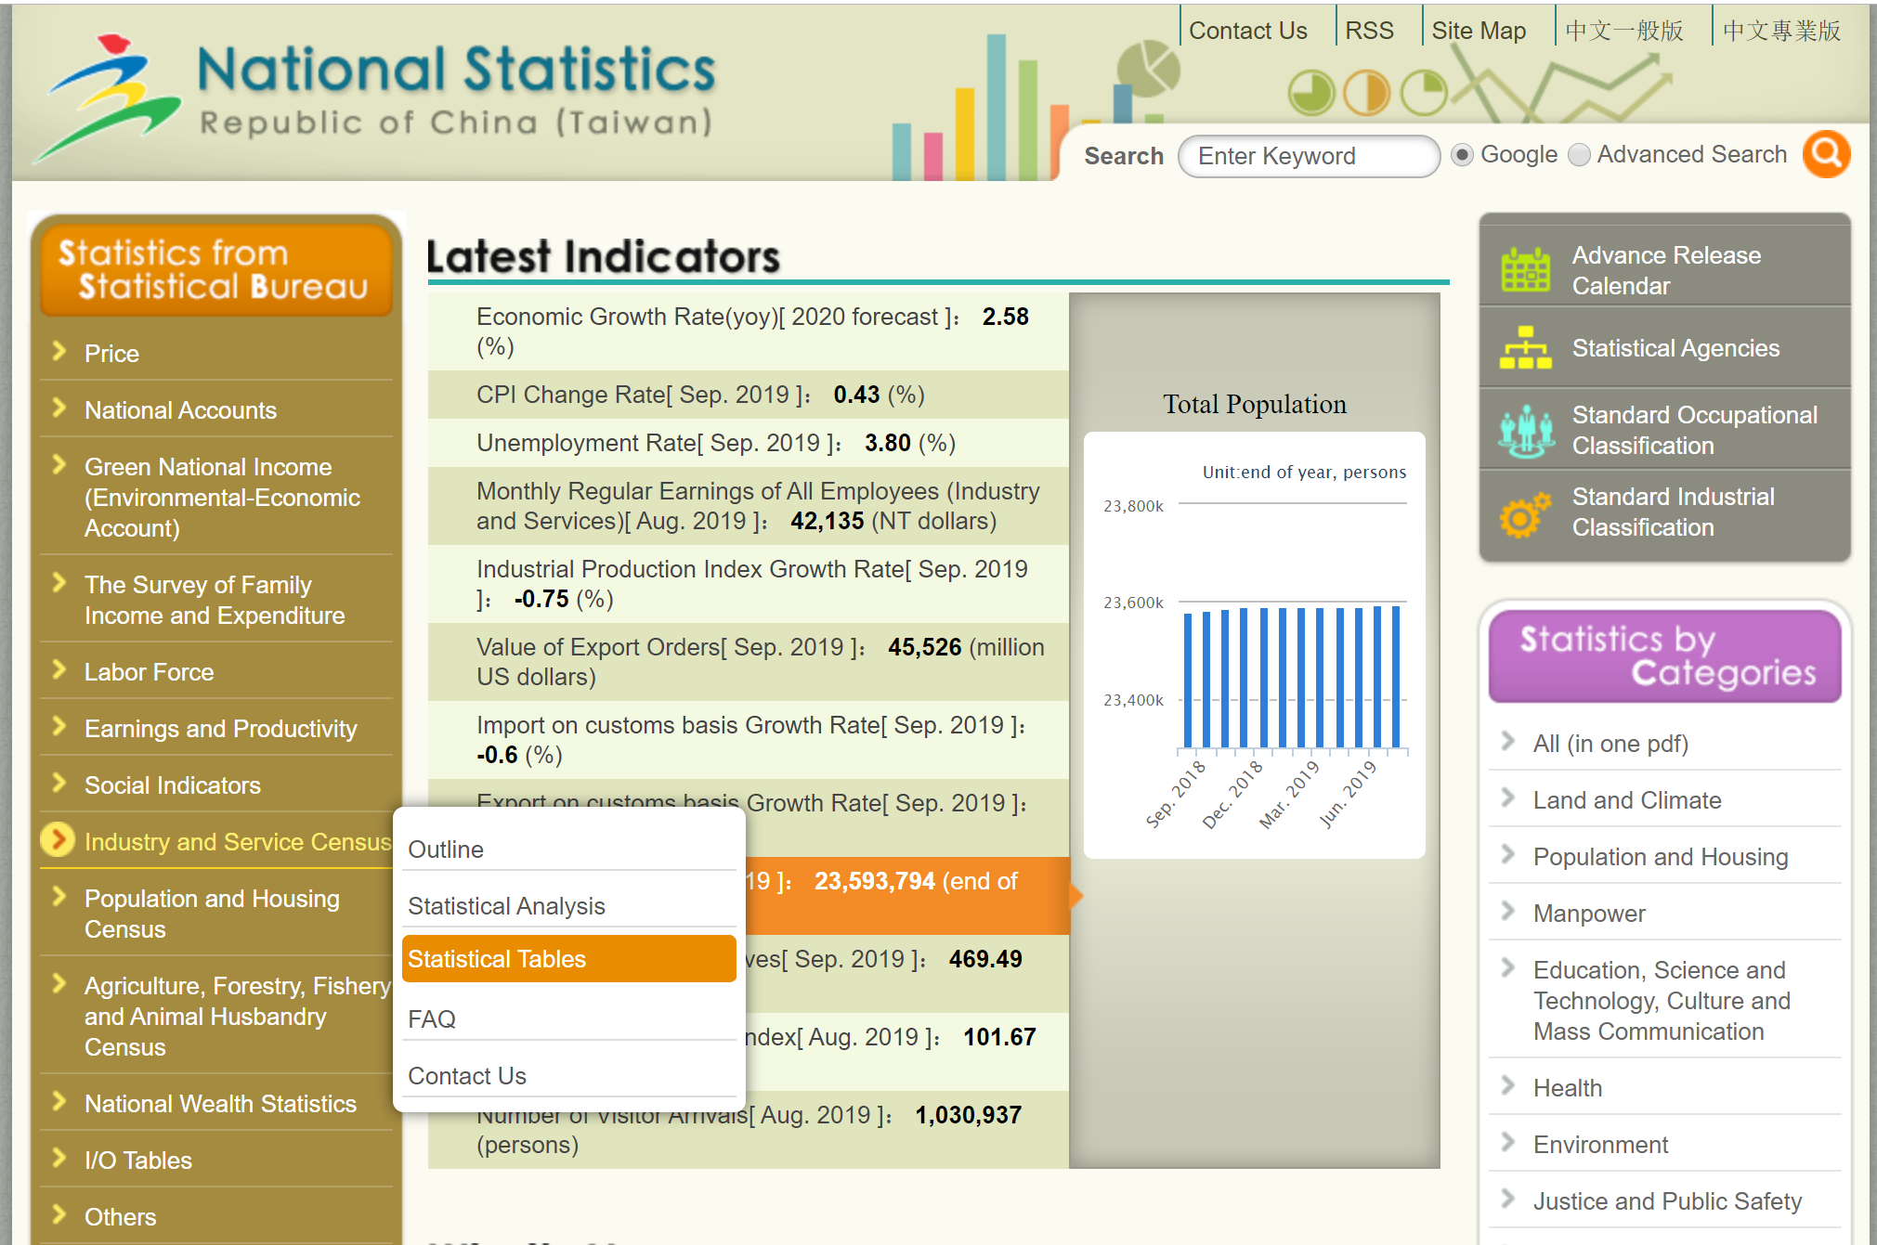
Step 2
Obtain the Data for Manufacturing and Financial Information Related to Industry
1. Go to:
2. On the left menu, click on “Industry, Commerce and Service Census” and then on “Statistical Tables”
eng.stat.gov.tw

Slide 4
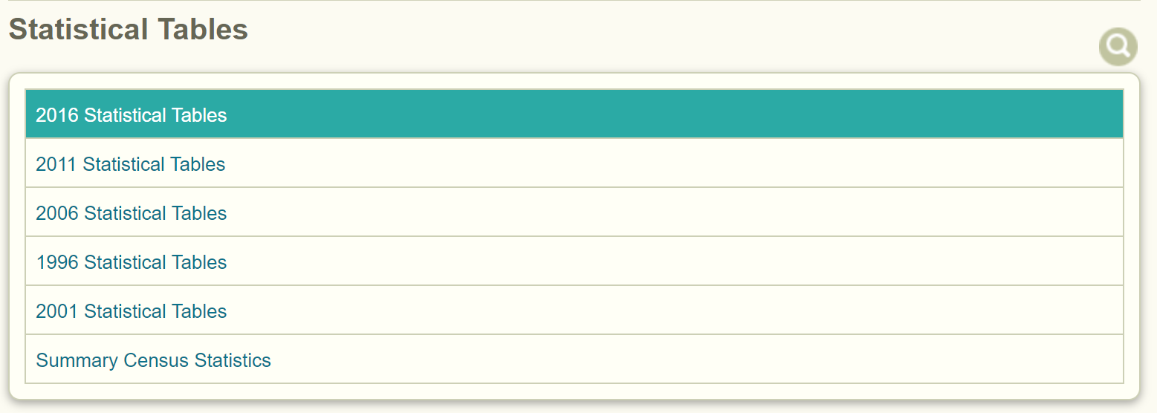
Step 2
Obtain the Data for Manufacturing and Financial Information Related to Industry
3. Click on the latest year Statistical Tables (or the year of interest)
4. Download the Excel file for “Operation Status of Enterprise Units of All Industries, by Industry Group” file.

Slide 5
Step 2
Obtain the Data for Manufacturing and Financial Information Related to Industry
Locate the industry of interest in the different worksheets of the excel file.
E.g.-“Manufacture of Plastic Products” from worksheet “2”
Locate & record the following values:
-Total revenues
-Total expenditures
-Expenditures of labor compensation
-Gross value of production

Slide 6
Step 2
Obtain the Data for Manufacturing and Financial Information Related to Industry
Use the USA “Annual Survey of Manufacturers” data to obtain Production Worker Annual Wages as a percentage of Annual Payroll
See the ICP procedure for USA for steps to locate values for:
-Annual Payroll
-Production Worker Annual Wages
Find the Industry of interest by NAICS code
Step 2
Obtain the Annual Payroll & Production Worker Annual Wages
Step 3
Step 1
Express Production Worker Annual Wages as a percentage of Annual Payroll
ICP USA

Slide 7
Step 2
Obtain the Data for Manufacturing and Financial Information Related to Industry
For the “All other plastics product manufacturing-NAICS 326199” :
-Annual Payroll 17,287,408
-Production workers annual wages 10,813,972
Production Worker Annual Wages/ Annual Payroll is 63%
ICP USA

Slide 8
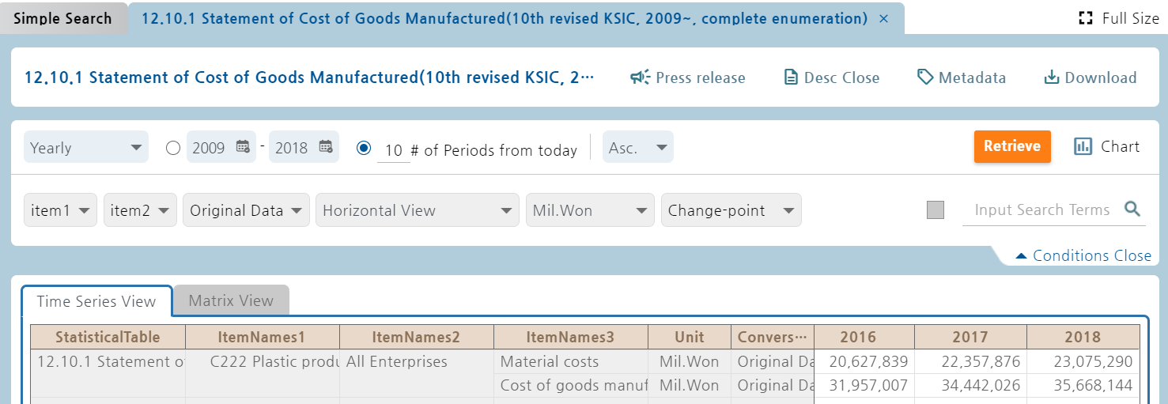
Step 2
Obtain the Data for Manufacturing and Financial Information Related to Industry
Using the DM-to-COGS ratio from Korean ICP as an estimate for Taiwan.
See the ICP procedure for Korea for steps to locate values for:
-Material costs
-Cost of goods manufactured
ecos.bok.or.kr/
Direct Material/Cost of Goods Sold = 23,075,290/35,668,144 = 65%
ICP Korea

Slide 9
Step 3
Use Financial and Manufacturing Information to Calculate Ratios
In Taiwan, follow 6 steps to find DM, DL,MOH,COGS, GSA & PBT.
1. Calculate Direct Labor
1.
 | Expenditures of labor compensation | 71,264,058
 | DL/TL (from USA data) | 63%
 | Total revenues | 539,897,891
 | Direct Labor | 8.3%
DL= (Expenditures of labor compensation x 63%) / Total revenues
=0.63*(71,264,058/539,897,891)

Slide 10
Step 3
Use Financial and Manufacturing Information to Calculate Ratios
Steps: 2 - 3
2. Calculate Cost Of Goods Sold (COGS) as percentage of Sales
3. Apply Korean data as proxy for the following ratio to determine Direct Material (DM):
Direct Material/Cost of Goods Sold: 65%
DM =COGS * 65%
 | Total revenues | 539,897,891
 | Gross value of production | - 142,793,516
 | Cost Of Goods Sold | = 397,104,375
 | Cost Of Goods Sold | = 397,104,375
 | Total revenues | 539,897,891
 | COGS | 74%
 | DM/COGS | 65.0%
 | Direct Material (DM) | =0.65*74%
 | DM | 48%
2.
3.

Slide 11
Step 3
Use Financial and Manufacturing Information to Calculate Ratios
4. Calculate MOH % as follows:
 | COGS | 74%
 | DL | - 8.3%
 | DM | - 48%
 | MOH | 17.7%
4.
MOH = COGS - DL - DM

Slide 12
Step 3
Use Financial and Manufacturing Information to Calculate Ratios
5. Calculate Profit Before Tax (PBT) as follows:
 | Total revenues | 539,897,891
 | less Total expenditures | - 480,676,979
 | Profit Before Tax | = 59,220,912
 | Profit Before Tax | 59,220,912
 | Total revenues | 539,897,891
 | PBT | 11%
4.
PBT = (Total revenues –Total expenditures) / Total revenues

Slide 13
Step 3
Use Financial and Manufacturing Information to Calculate Ratios
6. GSA & Other Expenses as a below formula:
 | Total | 100%
 | COGS | - 74%
 | PBT | - 11%
 | GSA & Other Expenses | 15%
4.
GSA & Other Expense= 100-COGS-PBT

Slide 14
Present all your calculated ratios in the cost breakdown format
Industry cost profile for “Plastics Product Manufacturing”
 | Direct Material (DM) | 48%
 | Direct Labor (DL) | 8.3%
 | Manufacturing Overhead (MOH) | 17.7%
 | Cost of Goods Sold (COGS) | 74%
 | GSA & Other Expenses | 15%
 | Profit Before Tax (PBT) | 11%
 | Total Sales | 100%
Manufacturing data
Source Republic of China (Taiwan)
Financial data
Source: Republic of China (Taiwan)

